Slide 1
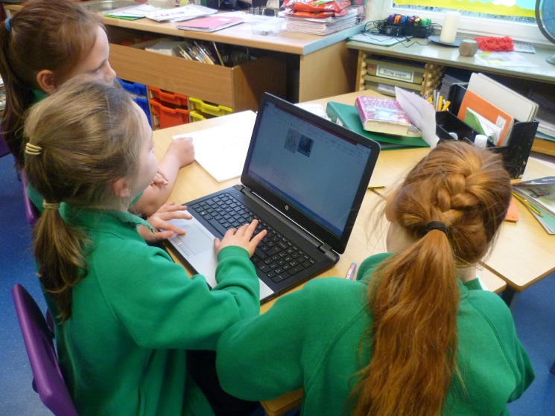

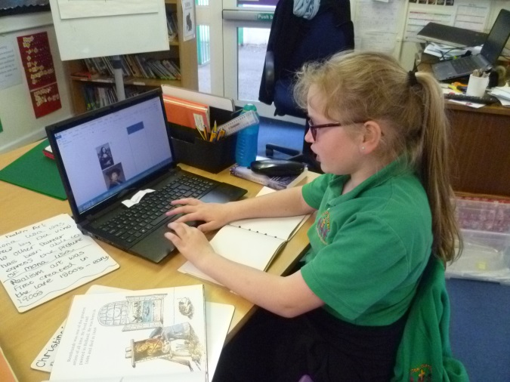
Helping your child to learn on-line.

Slide 2
Safety first!
In one of our classes 22 out of 29 children said they had seen something on the Internet that had frightened or upset them.
17 of them hadn’t told a grown-up!
Safe searching
www.kidrex.org
www.swiggle.org.uk
www.kidzsearch.com
YouTube kids app (beware of advertising)

Slide 3
Making maths fun (free on-line).
Active Learn (Abacas)
www.activelearnprimary.co.uk
User name : child’s name and initial (all in lower case) e.g. zoep
Password: child’s class name (all in lower case) e.g. wrens
School code: ljsw (lemon jelly sausage winder)
Some games do not work on tablets
ICT games
www.ictgames.com
Multiplication.com (not just multiplication) and Times table me
www.multiplication.com www.timestableme.com
Mathplayground.com and Mathsframe
www.mathplayground.com www.mathsframe.co.uk
Snappy maths
www.snappymaths.com

Slide 4
Making maths fun – (apps)
Doodle Maths
Doodle Tables
Squeeble Maths (various)

Slide 5
Exciting English
Reading
Oxford Owl
www.oxfordowl.co.uk
Free on-line e-books and audio books that all form part of our new reading scheme.
Inference Ace (app)
Great for children who struggle to comprehend
Writing, spelling and grammar
ICT games
www.ictgames.com
Phonics Play
www.phonicsplay.co.uk
This sight is subscription based with some free content
Sentence Play
www.sentenceplay.co.uk

Slide 6
Great all-rounders
Busy Things (Nursery to Year 2)
www.busythings.co.uk
All our EYFS and KS1 children have an account (check with teachers for log-in details)
Twinkl
www.twinkl.co.uk
Printable resources for every subject. There is some free content.
BBC Education
www.bbc.co.uk/education
Clips, games and information about a wide range of subjects.
Great for understanding spelling and grammar rules.
Oxford Owl
www.oxfordowl.co.uk
As well as the books, Oxford Owl has a range of free games, parental advice and fun activities to support learning.
Primary Homework Help
www.primaryhomeworkhelp.co.uk

