Slide 1

Sutton Courtenay C of E Primary School: How we support children with
Special Educational Needs & Disabilities (SEND)

Slide 2
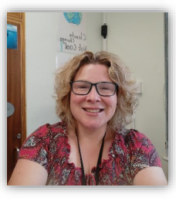
SENDCo welcome
I’d like to introduce myself and give an outline of how SEN works at Sutton Courtenay C of E Primary school.
I’m Laura Sykes and have been working at Sutton Courtenay since January 2025.
I’m passionate about all children being able to attend their local primary school to learn, thrive, and be part of the whole community.
The school team share this vision and look forward to getting to know you as Parents & Carers and your children.
My working days are Tuesdays, Wednesdays & Thursdays and I can be contacted on
LSykes@sutton-courtenay.school
Phone:01235 625731

Slide 3

Early Identification is a key factor in improving outcomes for children
Children’s brains are very flexible and intervention put in at a young age can benefit pupils at a neurological level and improve their life-long learning and achievement.

Slide 4

Section 6.14 of the SEN Code of Practice
‘All schools should have a clear approach to identifying and responding to SEN. The benefits of early identification are widely recognised – identifying need at the earliest point and then making effective provision improve long-term outcomes for the child or young person.’

Slide 5

Evidence shows primary schools that excel rely on universal Quality First Teaching (QFT) strengthened by additional support.​
Universal High-Quality Teaching​
QFT ensures all students receive strong instruction with clear explanations and structured lessons from the start.​
Proactive Adaptations​
Embedding visual aids and breaking tasks into steps anticipates diverse needs and reduces learning barriers.​
Inclusive Environment and Expectations​
QFT promotes high expectations and positive attitudes, benefiting all students in a supportive classroom.​
Ongoing Assessment and Support​
Regular assessment helps teachers adapt lessons in real time, ensuring no student is left behind.​

Slide 6
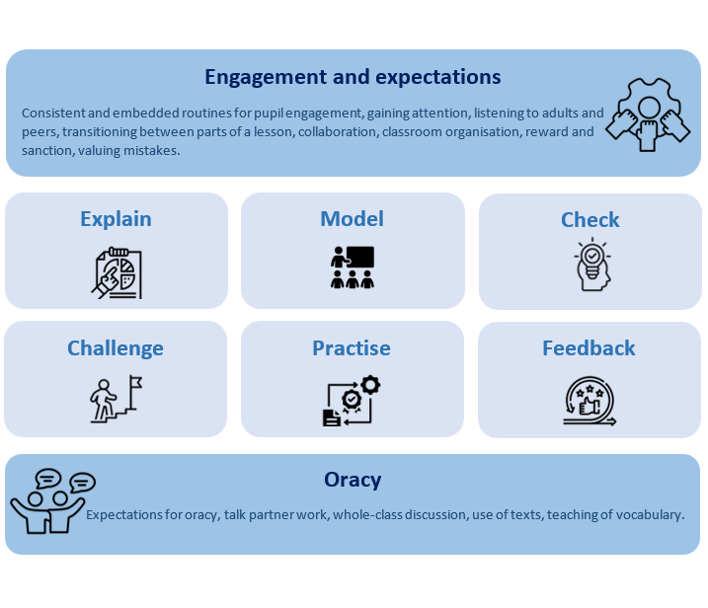
RET Primary Teaching and Learning framework

Slide 7

If your child’s progress in any prime area gives cause for concern, the Class Teacher will...
Consider the child’s date of birth and any contextual information about your child, such as attendance.
Discuss this with you as parents / carers and agree how to support your child.
Consider whether your child may have a Special Educational Need or Disability (SEND) which requires additional support, using the Oxfordshire SEND Framework and Toolkit.
Ordinarily Available Toolkit |
Link with and help you as families to access relevant services from other agencies as appropriate.

Slide 8

Sutton Courtenay C of E Primary School employs a holistic approach...
All the information is brought together and considered with you as the child’s parents/carer. This includes information about:
The child’s learning and development, within and beyond the setting.
Teacher & TA observations, formal checks, any other detailed assessment, any specialist advice;
Progress in the criteria for SEND: Communication and Interaction, Cognition and Learning, Social, Emotional and Mental Health, and Sensory and/or Physical Needs.

Slide 9

Parents know their children best ......
Discussions with parents can give Teacher's insights into a child’s personality, feelings or interests . There may be changes in a child’s life which parents may not have mentioned, perhaps because they did not feel that they were important or because they are very personal, e.g:
Illness or bereavement in the family
Parents separating
A change of carer or child-minder
Living in temporary or unsuitable accommodation
The child’s disturbed sleeping pattern
A new baby

Slide 10

Voice of the Child
Children may express their wishes, views and feelings for themselves in a range of ways.
We can support interactions and dialogue with children by using visual prompts , photos and a range of child –friendly tools to get them to show what they like doing and what they find difficult.
Teachers can also understand children’s views by observing the choices they make , what they like to do and what they avoid.
Teacher & TA observations are a purposeful part of everyday practice, and it may be these that will initially alert practitioners to a delay or barrier in a particular area.

Slide 11

Language development is accepted as being critical to learning, cognitive development and literacy...
It is expected that when a child starts primary school, they will be able to understand much of what is said, express themselves clearly, share their feelings and make their needs known.
A child who struggles to speak will often struggle to read and write, (can be compounded if children are taught to read and write before their spoken language skills are developed enough) to access this teaching.
Children with Speech, Language &Communication needs can become withdrawn or present with challenging behaviour .
Pupils are screened with the Wellcom Assessment tool when they start in Nursery and Reception.

Slide 12
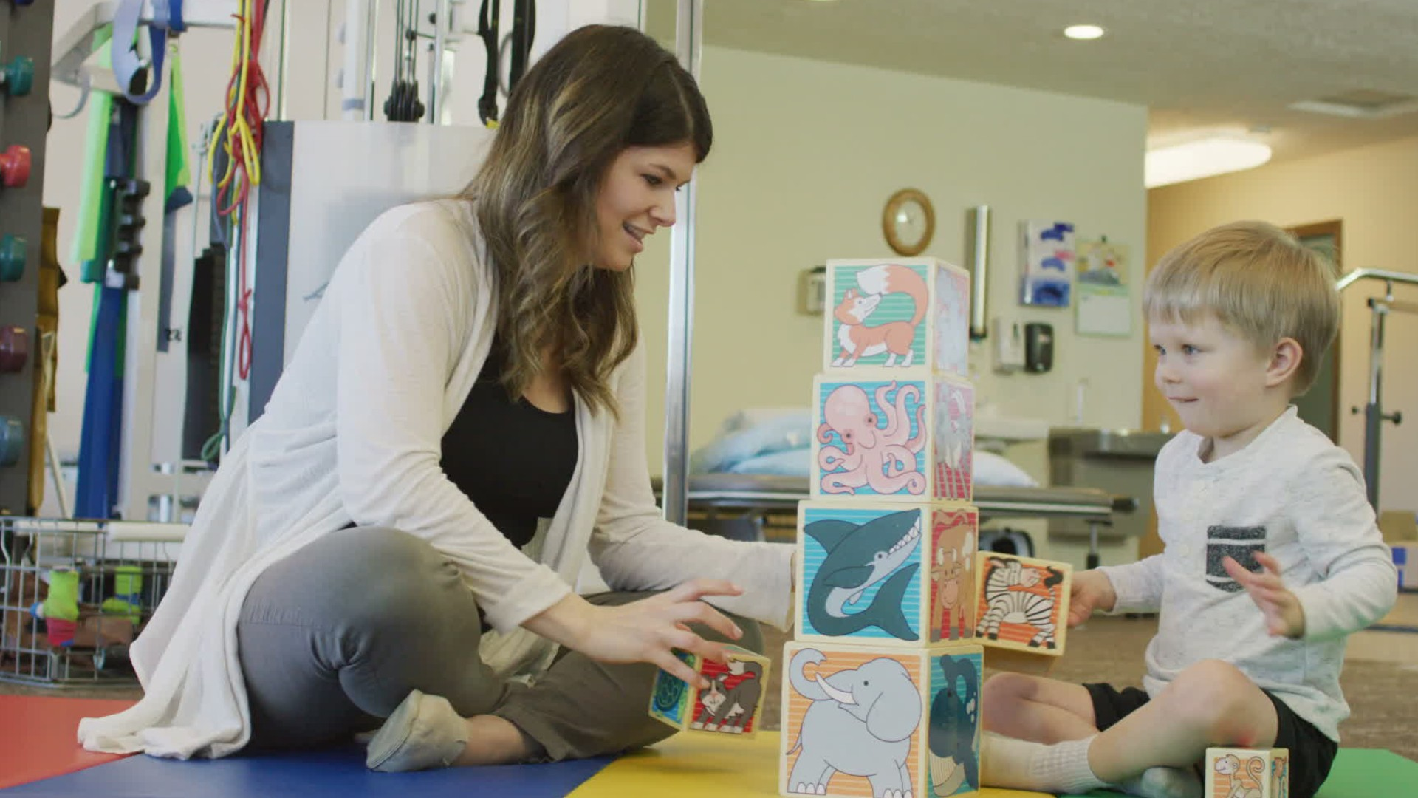
Support for Speech, Language, Communication & Interaction (SLCI)
We use a combination of whole‑school strategies, targeted support, and specialist interventions to help pupils develop strong speech, language, communication and interaction skills. Support is put in place early to prevent pupils from falling behind.
Communication and interaction | Oxfordshire Schools

Slide 13
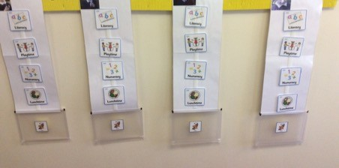
High‑Quality Classroom Teaching
Teachers embed communication‑friendly approaches as part of everyday learning, such as:
Using clear, consistent language
Modelling good vocabulary
Visual supports (e.g., pictures, timelines, symbols)
Giving extra processing time
Structured routines
Breaking instructions into smaller steps
These universal strategies benefit all pupils and create an environment where speech and language needs are recognised early.

Slide 14

Early Identification and Assessment
We use:
Teacher observations
Language screeners (e.g., WellComm)
Classroom checklists
Input from parents/carers
Early identification means support can begin quickly rather than waiting for pupils to fall behind.

Slide 15

Targeted Interventions
When pupils need more help, tailored interventions are used to strengthen specific skills, such as:
Vocabulary groups & pre-teaching
Narrative or storytelling groups
Phonological awareness programmes
Social skills groups (e.g., turn‑taking, conversation rules)
LEGO® therapy to support interaction
Speech sound practice when advised by Speech and Language Therapists (SaLT)
These sessions are often delivered by trained teaching assistants under guidance from SENCo or SaLT.

Slide 16

Specialist Support
If difficulties are more significant, schools may involve:
Speech and Language Therapists (SaLT)
Early Years SEN Advisory Teacher (EYSENAT)
SENSS Communication & Interaction (C&I) advisory teachers
Specialists assess pupils, recommend personalised targets, and train staff to deliver programmes effectively.

Slide 17
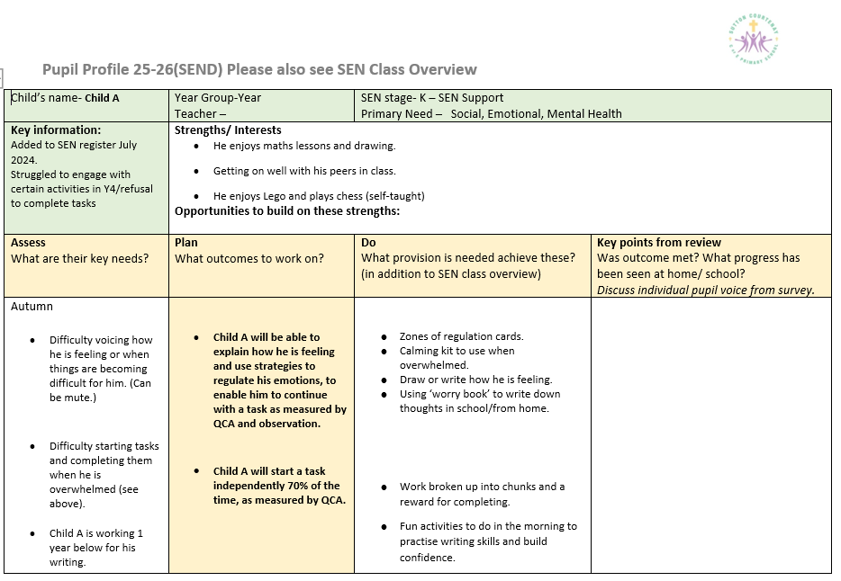
SEN Pupil Profile
For children with ongoing SEN needs, we create a SEN Pupil Profile that includes:
Input from parents and professionals
Specific targets
Teaching strategies
Intervention
Progress data
Review dates

Slide 18
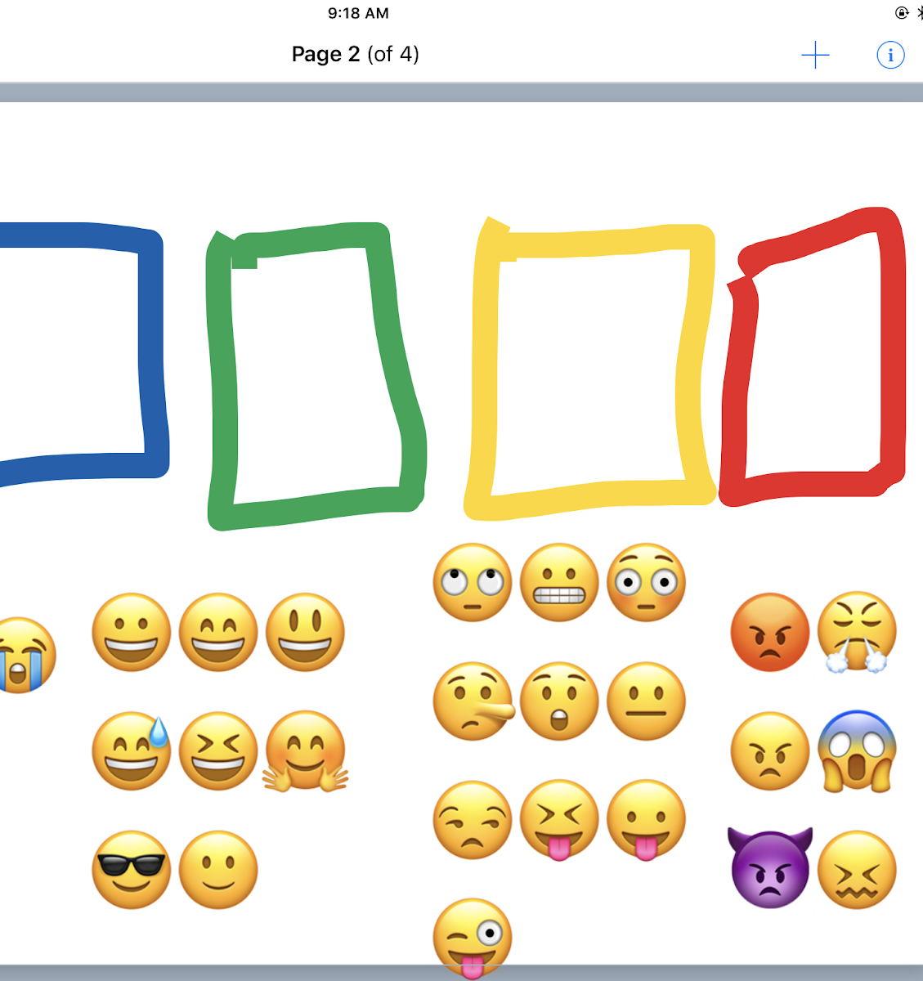
Support for Social Communication & Interaction
For pupils with social communication needs (including autistic learners), schools may offer:
Structured play sessions & social skills interventions
Visual timetables
Social stories and comic‑strip conversations
Zones of regulation
Quiet breakout spaces
Support for transitions and unstructured times

Slide 19
Creating a Communication‑Friendly School Culture
This includes:
Staff training
Using consistent visuals throughout the school
Encouraging oracy and Talk Partner discussion in lessons
Providing calm, organised classrooms with consistent routines & high expectations
Encouraging peer‑to‑peer communication

Slide 20

Early identification of literacy difficulties is vital
Key risk factors for literacy difficulties are:
• Speech & language difficulties
• Difficulty acquiring letter knowledge – both sounds and letter names
• Poor phoneme awareness and difficulty sounding out words for reading
• Poor ability to segment and manipulate phonemes for spelling

Slide 21
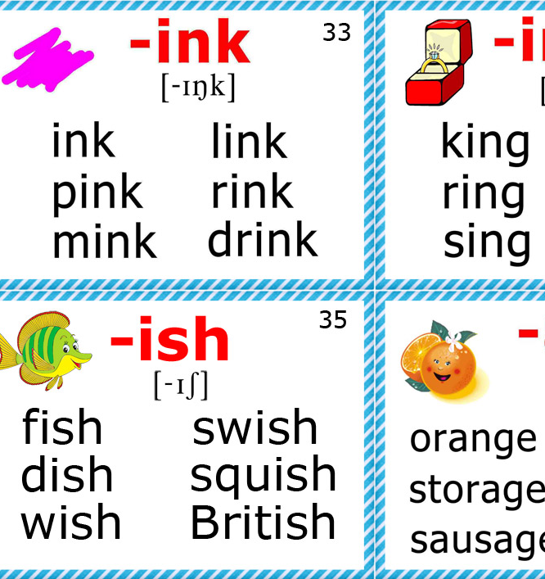
Support in phonics
ELS (Essential Letters & Sounds) is our synthetic phonics programme which we use to teach children learn to read in Reception and Key Stage 1. Our approach also involves.
Daily Story Reading of Picture Books in Reception & Key Stage 1
Monitoring of Pupils Reading Progress through a fluency tracker and Dolch Sight Vocabulary ( 220 words make up approximately 70 % of all reading matter, allowing children to develop fluency in reading.)
A Reading Diary accompanies home reading books.
Regular assessments ,culminating in the national Year 1 Phonics Screening Test. Children scoring below the national benchmark will be identified & supported through intervention in Year2 and re-tested at the end of Year 2. Phonics continued to be targeted throughout years 3-6 for children who continue to need additional support,
Further assessments -Literacy Assessment Pack (LAPack) or Phonological Assessment Battery (PhAB).

Slide 22

What is ELS & Synthetic Phonics?
Synthetic phonics is a way of teaching children to read. It teaches children how sounds are represented by written letters. Children are taught to read words by blending these sounds together to make words. For example, they will be taught that the letters ‘m-a-t’ blend together to make ‘mat’. A synthetic phonics programme, such as ELS, is a structure for teaching these sounds in a certain order to build up children’s learning gradually. It is used daily during Reception and Years 1& 2 to teach all the sounds in the English language. Children learn the letters that represent the sounds. They are then asked to read words and sentences with the new sounds in. Children will also practise writing the letters that represent the sounds.
Essential Letters and Sounds - Oxford Owl

Slide 23

Children who are struggling to learn to read will take home ‘ELS . decodable books. Parents and carers will be invited to meet with the class teacher and/or SENCo to discuss how they can give increased home support to their child as well as the child being read with every day at school.
In some circumstances it might be felt that a phonics approach to learning to read is unsuccessful for a child. In which case the SENCo, Class Teacher and parents/ carers will meet to discuss the best way forward to support learning, and other approaches will be explored.
Some children may learn to read through a whole word recognition approach and Precision Teaching , as well as daily reading is used to support this.
SEN Pupil Trackers are used to monitor progress & are shared with the parents termly.

Slide 24

Understanding Cognition & Learning Needs (C& L)
Children may process information differently, affecting reading, writing, maths, memory, and problem solving.​
Effective Teaching Strategies​ involve simplifying and repeating instructions, using visual support and checklists , hands-on learning , and opportunities for pre and over-learning to support comprehension and retention.​
Parental Support and Confidence Building​-Celebrating small achievements and avoiding comparisons help build children's confidence and motivation.​
Home-School Collaboration​-Regular communication and shared strategies between parents and teachers ensure consistent support.​
Cognition and learning | Oxfordshire Schools

Slide 25

Support for Social & Emotional Mental Health (SEMH)
Children with SEMH needs may experience difficulties with relationships, emotions, behaviour, confidence, resilience or coping with school expectations. We have well‑established systems to identify needs early and provide appropriate support.
We recognise that SEMH needs can appear in many forms, including:
Becoming withdrawn, isolated or anxious
Struggling with friendships or social understanding
Challenging or distressed behaviour, mood changes or difficulty regulating emotions
Low self‑esteem, difficulty coping with change, or avoiding tasks or school situations
These behaviours often reflect underlying emotional or mental health needs.

Slide 26
Support Available to All Pupils
Identification involves direct observation, screening tools and progress monitoring where necessary.
We provide a supportive environment that benefits all children, especially those with SEMH needs. This includes:
A positive whole‑school ethos and inclusive environment supporting wellbeing and respect
Predictable routines and clear expectations
Staff training to confidently support children’s emotional wellbeing
Opportunities to develop social and emotional skills across the curriculum
The SENDCo, Laura Sykes, holds the DfE Mental Health Lead Teacher certificate.
We have a Home School Link Worker & Pastoral Lead TA who work with individual children, groups & families to support and signpost for further services.

Slide 27

Emotional & Behavioural Support
Nurture groups or small‑group sessions focused on emotional literacy (Beehive Buddies)
Check‑ins with a trusted adult
Teaching self‑regulation (Zones of Regulation) strategies or using calm spaces
Structured behaviour or anxiety‑management plans
Social skills groups to support relationships and peer interaction.
Clear, simplified instructions
Reduced sensory overwhelm / safe space to decompress
Support with transitions between activities
Visual timetables and emotional regulation tools
Evidence‑based interventions at classroom level can support behaviour, self‑regulation and learning outcomes.

Slide 28

Specialist or Additional Support
If further help is needed, we may involve:
Educational Psychologists
CAMHS Mental Health Support Teams (MHSTs) in schools
School nursing teams
Behaviour specialists
CAMHS (Child & Adolescent Mental Health Services) where clinically appropriate
OCC SEND services and toolkits, which include SEMH resources for parents and teachers
We use frameworks such as Oxfordshire Ordinarily Available SEND Toolkit
Social, emotional and mental health (SEMH) | Oxfordshire Schools

Slide 29

How Parents Can Work with us
Partnership is essential. Schools encourage parents to:
Share concerns early and discuss changes at home or school
Practice consistent routines and boundaries
Support emotional language (“naming feelings”)
Encourage friendships and play opportunities
Access local SEMH resources, toolkits or workshops recommended by the school or local SEND Local Offer
Working together helps create stability and builds emotional resilience.

Slide 30

Useful Parent‑Friendly Resources
CAMHS - Children’s & Adolescent Mental Health Service Resources for parents and carers | Oxford Health CAMHS
Anna Freud Mental Health Charity Services for Families | Anna Freud
National mental health guidance and wellbeing resources for parents (DfE) Promoting and supporting mental health and wellbeing in schools and colleges - GOV.UK
Charities like Young Minds for condition‑specific information and practical guides YoungMinds | Mental Health Charity For Children And Young People | YoungMinds

Slide 31
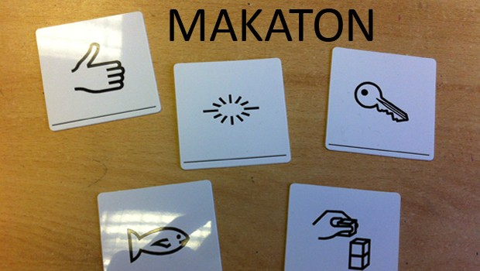
Physical and/or Sensory Needs
Children with physical or sensory needs may face challenges with mobility, hearing, vision, coordination, stamina, or how they access information. We work with families and professionals to ensure children can learn, participate and thrive.
What Are Physical & Sensory Impairments may include:
Hearing impairment – difficulties hearing sounds or speech, ranging from mild to profound loss.
Vision impairment – loss of sight that cannot be corrected with glasses or lenses.
Multi-sensory impairment (MSI) – combined hearing and vision impairments affecting communication, mobility and access to learning.
Physical Impairments-These may affect movement, coordination or stamina and may result from neurological, metabolic, medical or developmental conditions. They can significantly impact daily living and learning.

Slide 32
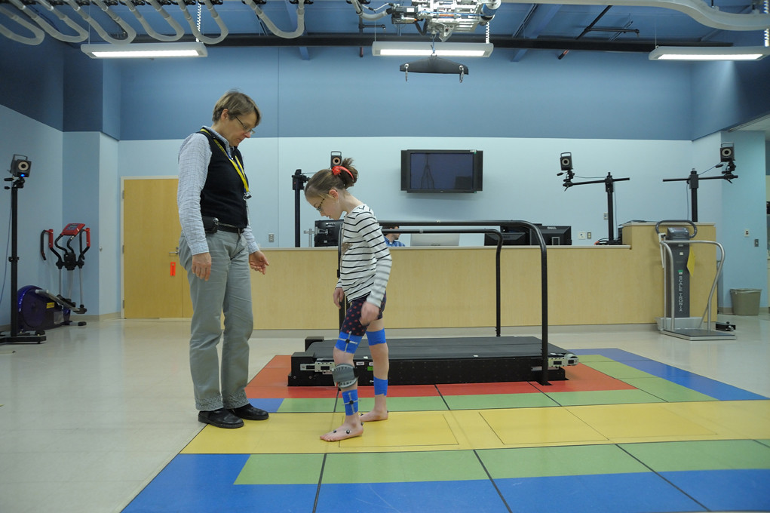
Identification may include:
Observation and assessment by teachers and SENCOs
Input from health professionals such as physiotherapists, occupational therapists, audiologists or ophthalmologists
Specialist assessments for motor difficulties (e.g., DCD) or sensory needs
Collaboration with parents to understand home experiences and early indicators
The identification process may involve teacher‑friendly tools to recognise motor, vision or hearing difficulties.

Slide 33

Universal Support (Available to All Pupils)
Foster an inclusive ethos and make reasonable adjustments to the environment and routines.
Ensure staff understand sensory and physical needs or can access specialist advice.
Provide accessible learning resources and adapt classroom layouts to ensure safe mobility.
Use multi‑sensory teaching approaches to help children access information in different ways (visuals, actions, movement).
Record and monitor children’s needs to adjust support as they grow.

Slide 34
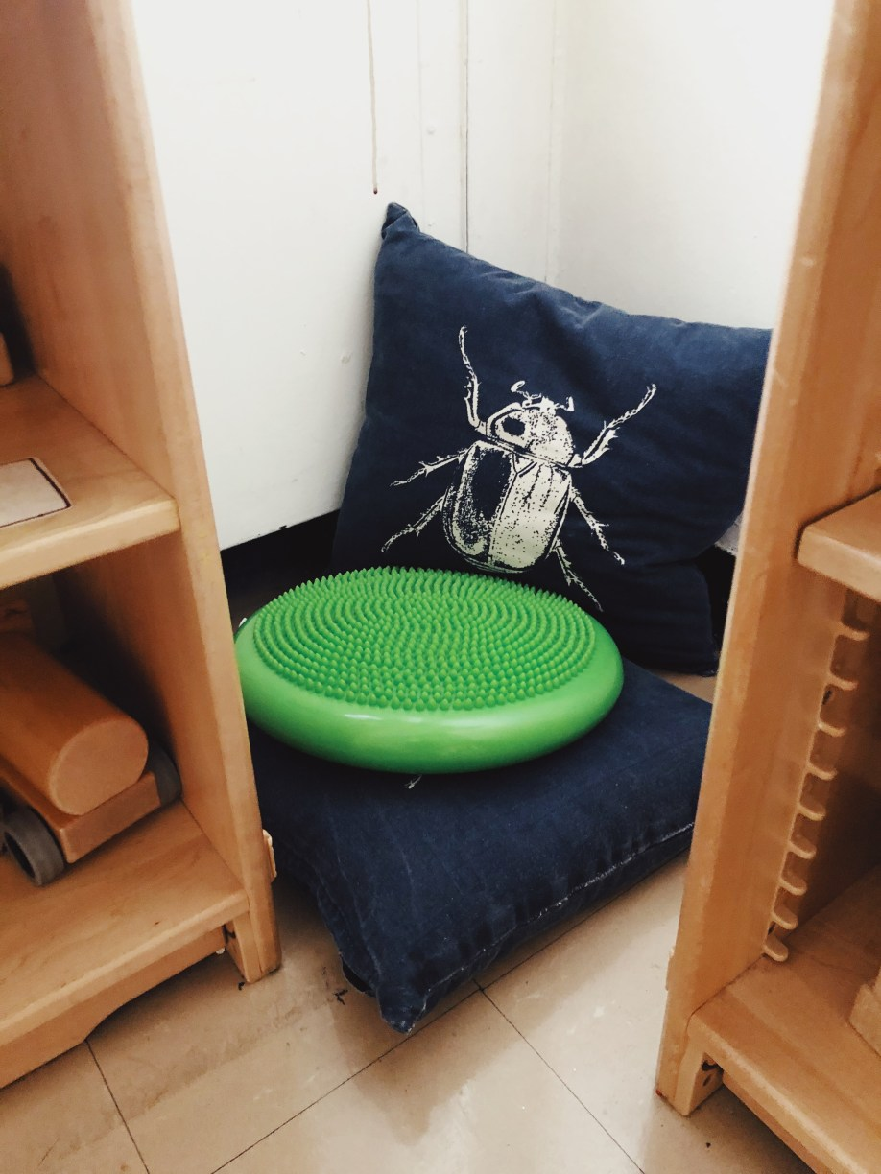
Targeted Support (Additional Help for Identified Needs)
For Sensory Needs
Hearing aids or FM systems (where medically advised)
Modified or enlarged print, tactile resources, braille or screen-reading software
Seating arrangements to support hearing or visual access
Reduced background noise and controlled lighting environments
For Physical Needs
Mobility aids, adapted furniture, ramps or handrails
Support with posture, positioning and movement breaks to avoid fatigue
Programmes targeting fine and gross motor skills
Adapted P.E. and safe access to playground areas
Assistive Technology
Research highlights that technology can play a key role:
Communication devices (AAC)
Assistive software for reading/writing

Slide 35

Specialist & Multi‑Agency Support
We work with professionals such as:
SENSS Advisory Teachers for vision, hearing or physical needs
Educational Psychologists
Physiotherapists and Occupational Therapists
Medical professionals and other health-based services
Parents play a key role in ensuring the right support is in place. You can:
Talk with the class teacher or SENCO if you notice mobility, hearing or vision difficulties.
Share medical reports or specialist assessments where available.
Discuss routines, fatigue management, comfort and equipment needs.

Slide 36

. Examples of Classroom Adjustments Your Child Might Receive
Visual timetables or tactile cues
Extra time to move around school safely
Adapted books or digital resources
Sloped writing boards or supportive seating
Alternative recording methods (e.g., typing, voice notes)
Quiet areas for sensory processing needs
Useful Resources for Parents
Schools may provide or signpost:
Local authority sensory/physical needs toolkits with strategies and guidance Sensory and physical | Oxfordshire Schools
Parent support hubs explaining SEND processes and school roles. [parentkind.org.uk]

Slide 37

We hope you found this information helpful.
Do get in touch if you have further questions LSykes@sutton-courtenay.school
Phone:01235 625731

